Slide 1
C♯ Lambdas and LINQ
λ
Rasmus Lystrøm
Associate Professor
ITU

Slide 2

Agenda
Delegates
Anonymous methods
Lambda expressions
Local functions
Anonymous types
Tuples
Extension methods
LINQ

Slide 3

Delegates

Slide 4
Delegates – Building block for Higher-order functions
public delegate int BinaryOperation(int x, int y);
static void Main(string[] args)
{
var add = new BinaryOperation(
delegate (int x, int y)
{
return x + y;
}
);
}

Slide 5
Delegates
Demo

Slide 6
Lambda Expressions
λ

Slide 7
Lambda Expressions
Action<string> write = s => Console.WriteLine(s);
Func<int, int> square = a => a * a;
Predicate<City> b = c => c.Name.StartsWith("B");
Converter<double, double> ftoC = c => c * 9.0 / 5.0 + 32.0;

Slide 8
Local functions I
static void Main(string[] args)
{
int square(int a) { return a * a; };
Console.WriteLine(square(16));
}

Slide 9
Local functions II
public static int LocalFunctionFactorial(int n)
{
return nthFactorial(n);
int nthFactorial(int number) => number < 2
? 1
: number * nthFactorial(number - 1);
}

Slide 10
Local functions III
public static int LambdaFactorial(int n)
{
Func<int, int> nthFactorial = default(Func<int, int>);
nthFactorial = number => number < 2
? 1
: number * nthFactorial(number - 1);
return nthFactorial(n);
}

Slide 11

Prerequisites

Slide 12
Anonymous types
var question = new
{
Title = "The answer...?",
Answer = 42
};

Slide 13
(Tuples)
var s = Tuple.Create("Clark Kent", "Superman");
var b = ("Bruce Wayne", "Batman");
var f = (name: "Barry Allen", alterEgo: "The Flash");
IEnumerable<(float x, float y)> GenerateCoordinates()
{
yield return (1.3f, 23.45f);
}

Slide 14
Data: Collection Initializer
IEnumerable<City> cities = new[]
{
new City(1, "Berlin"),
new City(2, "Hamburg"),
new City(3, "Frankfurt")
};

Slide 15
Data: Collection + Object Initializer
IEnumerable<City> cities = new[]
{
new City { Id = 1, Name = "Berlin" },
new City { Id = 2, Name = "Hamburg" },
new City { Id = 3, Name = "Frankfurt" }
};

Slide 16
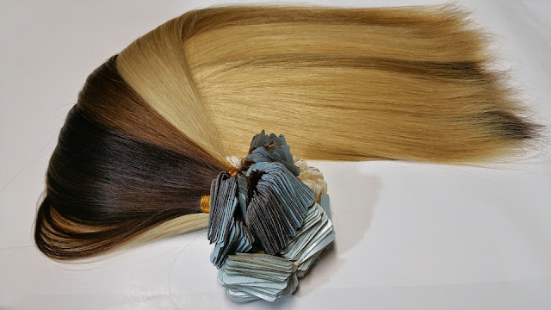
Extension Methods
This Photo by Unknown Author is licensed under CC BY

Slide 17
Extension methods 1/2
var count = cities.Count();
var sorted = cities.OrderBy(c => c.Name);
var filtered = cities.Where(c => c.Name.Contains("i"));
var pick = cities.FirstOrDefault(c => c.Id == 2);
var all = cities.All(c => c.Name.Length < 10);
var any = cities.Any(c => c.Name.StartsWith("B"));
var select = cities.Select(c => c.Name);

Slide 18
Extension methods 2/2
public static class Extensions
{
public static int WordCount(this string str)
{
return str.Split(
new char[] { ' ', '.', '?' },
StringSplitOptions.RemoveEmptyEntries).Length;
}
}

Slide 19
Extension Methods
Demo

Slide 20

LINQ – Language INtegrated Query

Slide 21
LINQ
var sorted = from c in cities
where c.Name.Contains("i")
orderby c.Name descending
select new { Name = c.Name };

Slide 22
Extension Methods Version
var sorted = cities.Where(c => c.Name.Contains("i"))
.OrderByDescending(c => c.Name)
.Select(c => new { Name = c.Name });

Slide 23
LINQ
Demo

Slide 24

Thank you
This Photo by Unknown Author is licensed under CC BY-NC-ND

